Slide 1
Comparison of Interpretability Techniques
Ya Liu
11/24/2020

Slide 2
1
2
Problem Statement
Two Models
CONTENT
3
4
Three Methods
Comparison

Slide 3
Problem Statement
01

Slide 4
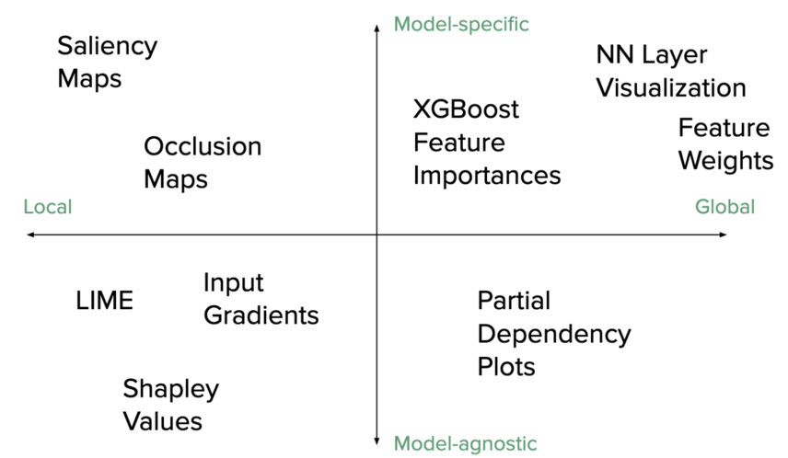

Here comes the problem
Dilemma: Interpretable or Powerful?
Some models are intrinsically interpretable, like linear models, but not very powerful. Deep neural network is more powerful but is difficult to interpret.
“Interpretability is the degree to which a human can understand the cause of a decision.” — Tim Miller
How to interpret deep neural network?
There are a wide range of interpretability techniques
Which interpretability techniques should I choose?

Slide 5
Let’s narrow down the problem
Two Models:
Pre-trained models: VGG16
One CNN model trained on digits image dataset.
Two Datasets:
MNIST digit image classification
Fashion product dataset
Three interpretability techniques:
DeepLIFT
SHAP
LIME
Three criteria:
Local vs. Global
Local Explanation: Why do you think this image is a cat?
Global Explanation: What do you think a “cat” looks like?
Model to explain
deep convolutional neutral network
Dataset to use
image classification

Slide 6
Two Models
02

Slide 7
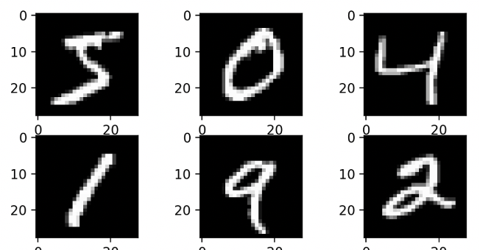
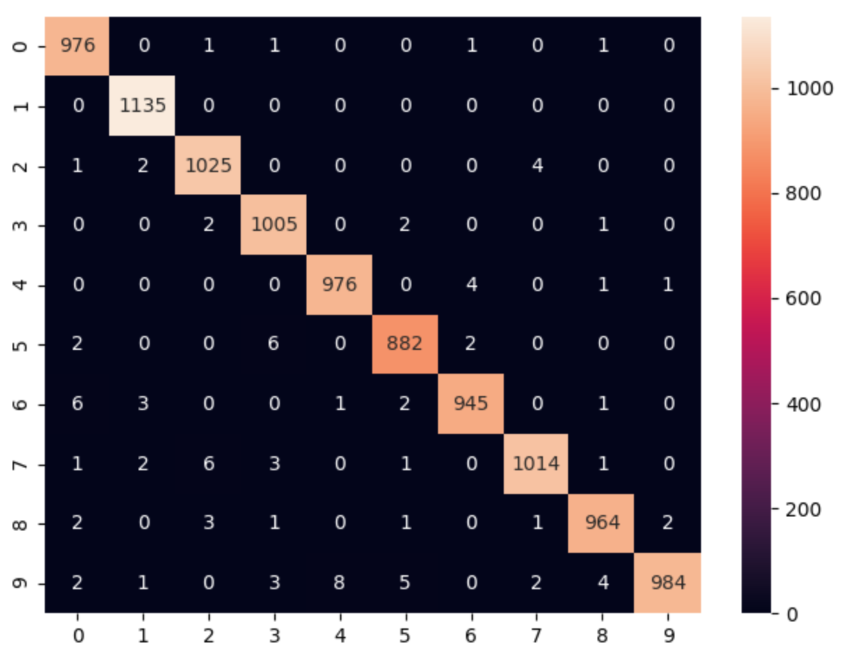
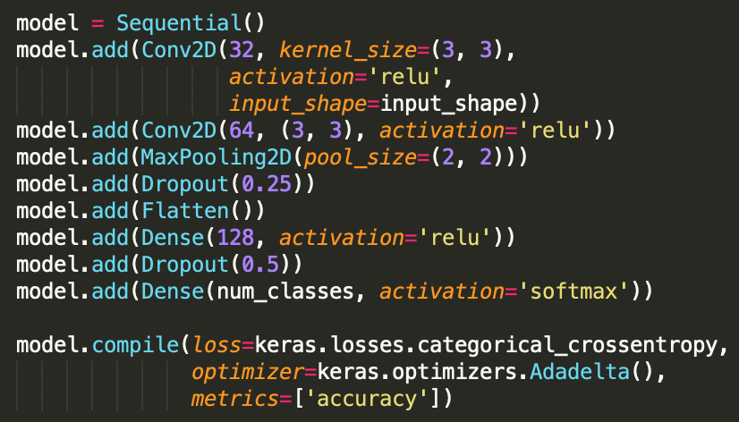
One CNN Model
Dataset: MNIST handwritten digit image
Model is powerful.
Model Structure

Slide 8
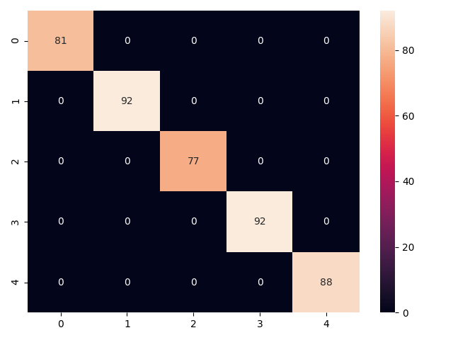
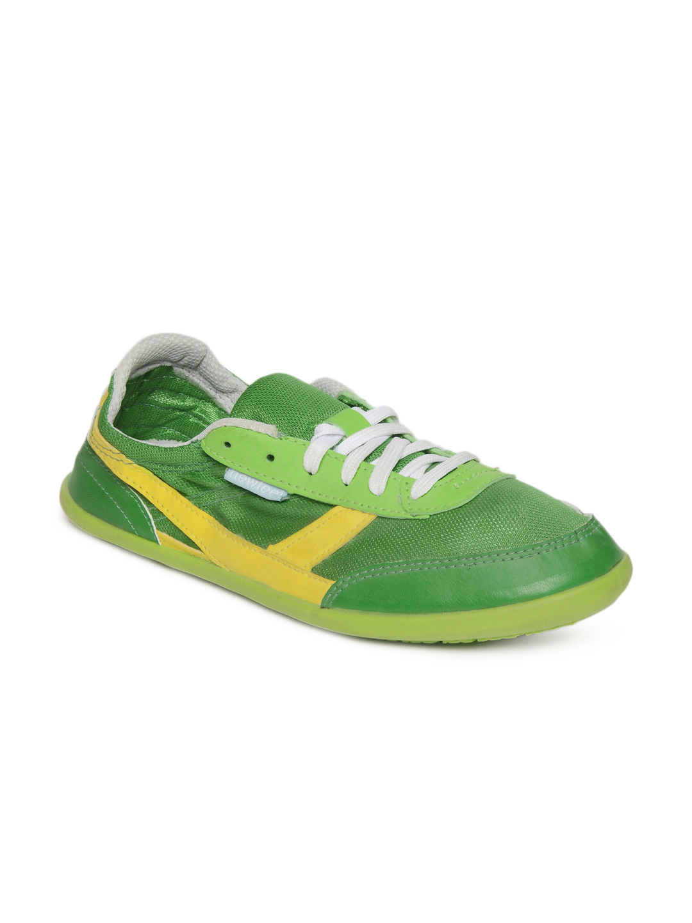


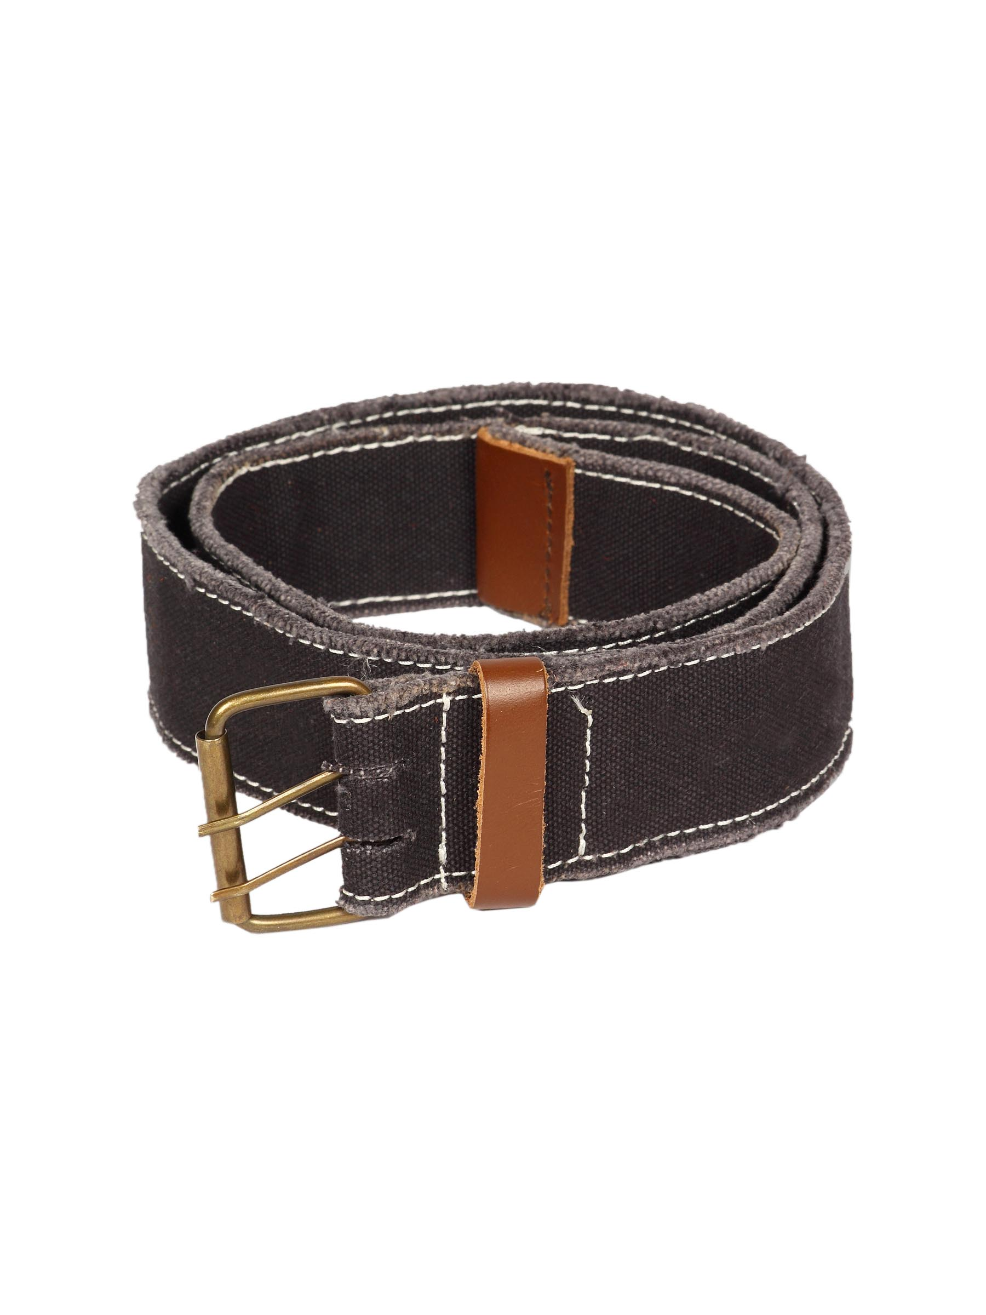
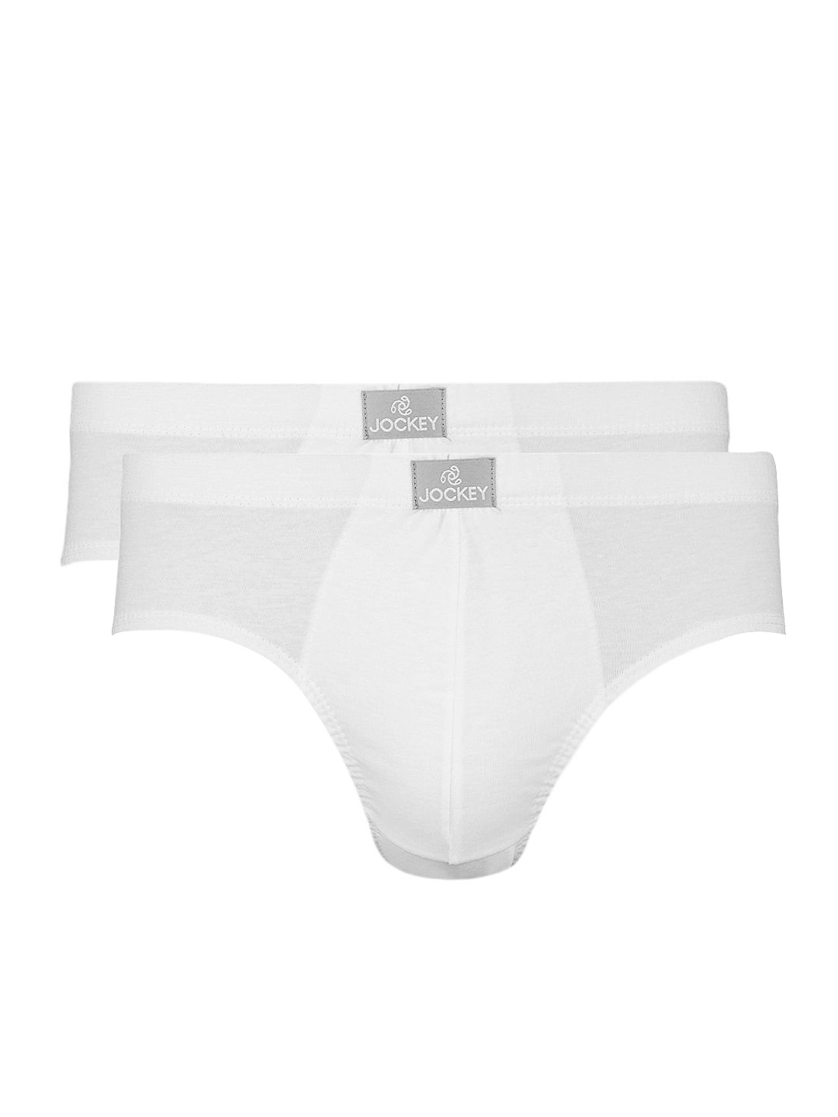
VGG16 Finetuned on Fashion Products Data
Choose five classes out of 143 classes
Backpacks: 724
Belts: 813
Briefs: 849
Casual Shoes: 1000
Flip Flops: 914
The model has a high accuracy.

Slide 9
Three Methods
03

Slide 10
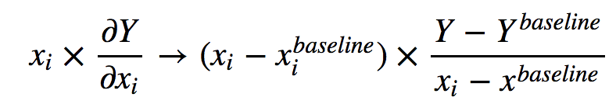
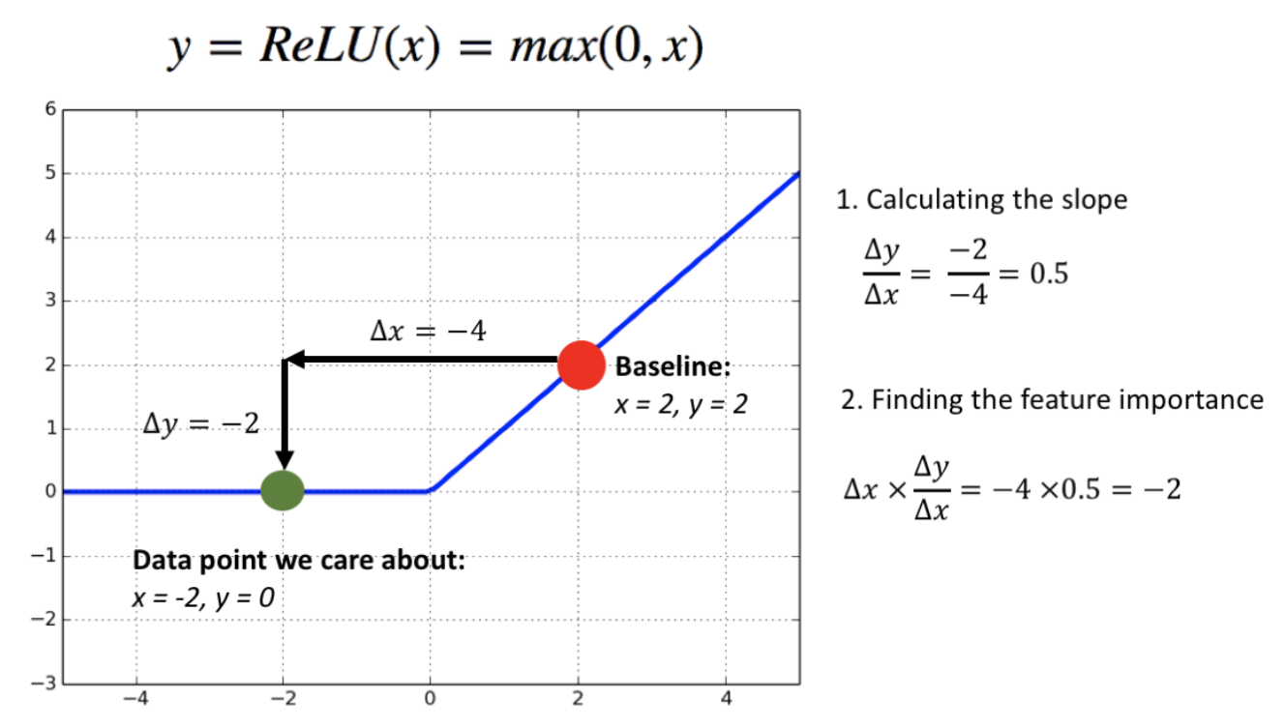
DeepLIFT (Deep Learning Important FeaTures)
Gradient: how the model’s prediction changes as the feature changes.
Gradient saturation problem: the feature has taken a value which has the most impact on the score globally, but the gradient fails to capture this importance.
How DeepLIFT fixes this problem?
Gradient describes how y changes as x changes at the point x
Slope describes how y changes as x differs from the baseline
Feature importance:
How to determine baseline?
take the mean of the dataset
an array of zeros
Implementation:
pip3 install deeplift
pip3 install tensorflow==1.15.2
pip3 install keras==2.3.1

Slide 11
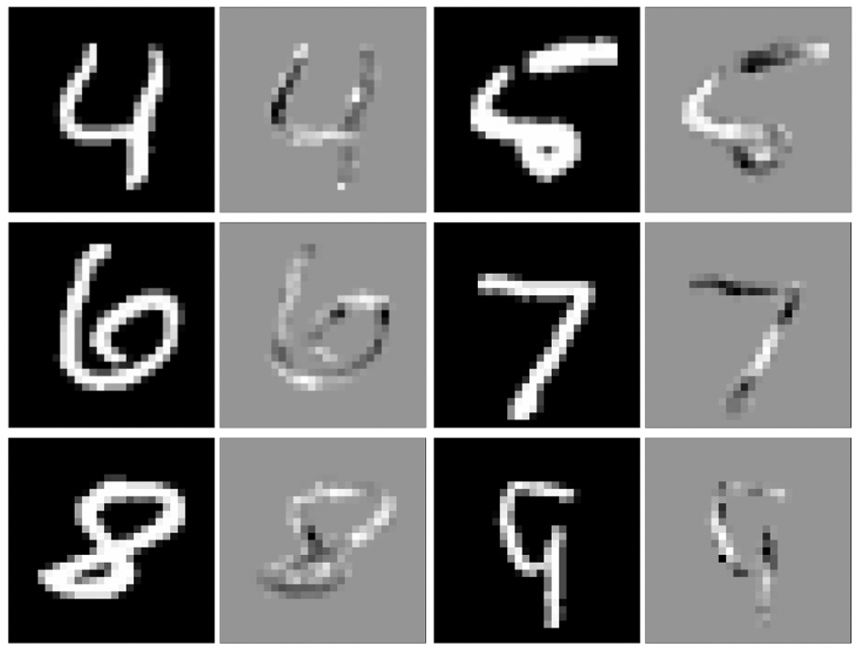
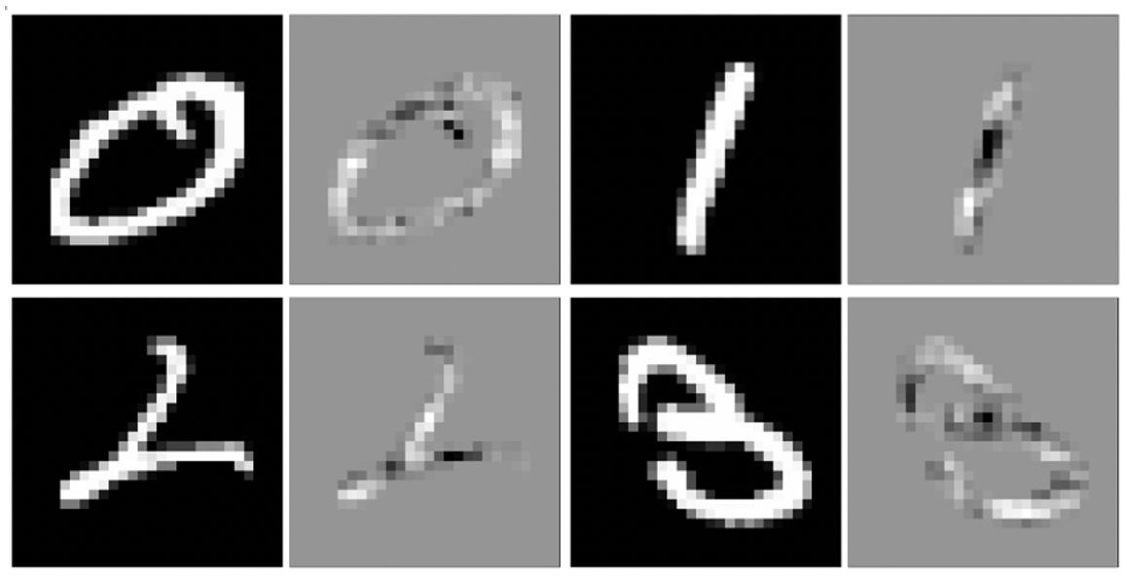
DeepLIFT explains handwritten digits
Baseline: an array of zeros

Slide 12
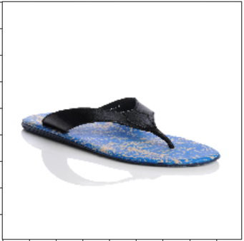
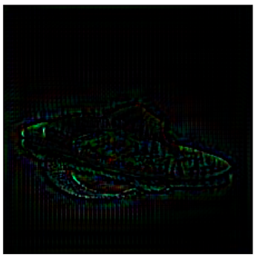
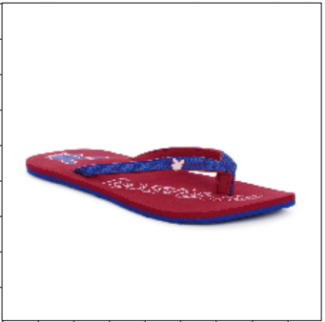
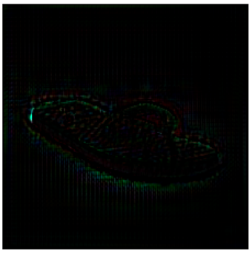
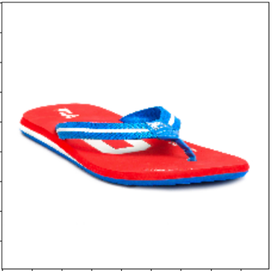
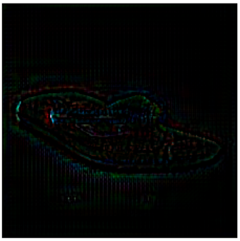
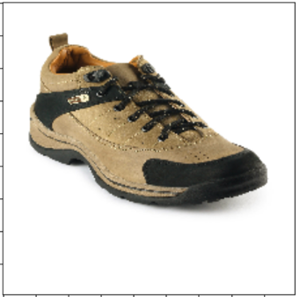
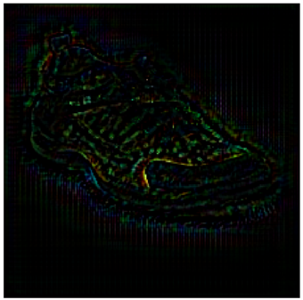
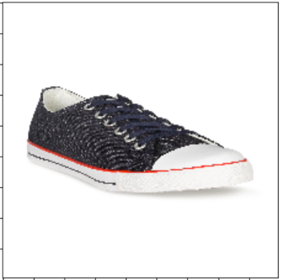
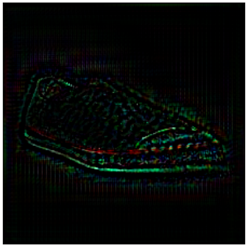
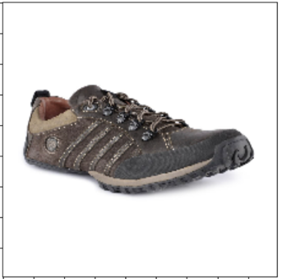
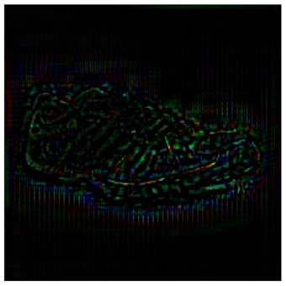
DeepLIFT explains casual shoes & flip flops
Baseline: an array of zeros

Slide 13
SHAP
SHAP (SHapley Additive exPlanations) is a game theoretic approach to explain the output of any machine learning model. It connects optimal credit allocation with local explanations using the classic Shapley values from game theory and their related extensions.
Shapley value
A solution concept in cooperative game theory. It measures each person’s contribution among coalition.
3 data scientists work together to write 100 lines of code.
V(L) = 10
V(L,M) - V(L) = 50 -10 = 40
V(L,M,N) – V(L,M) = 100 – 50 = 50
V(X) | Line of codes
L | 10
M | 30
N | 5
L, M | 50
L, N | 40
M, N | 35
L, M, N | 100
Order | L Contribution | M Contribution | N Contribution
L, M, N | 10 | 40 | 50
L, N, M | 10 | 60 | 30
M, L, N | 20 | 30 | 50
M, N, L | 65 | 30 | 5
N, L, M | 35 | 60 | 5
N, M, L | 65 | 30 | 5
Shapley value | 34.17 | 41.7 | 24.17
/6

Slide 14

SHAP
Implementation:
sudo pip3 install shap
keras==2.4.3, tensorflow==2.3.0
SHAP: a unified approach
KernelExplainer: explain the output of any function.
PartitionExplainer: explain the output of any function.
TreeExplainer: explain the output of ensemble tree models.
LinearExplainer: explain the output of a linear model
DeepExplainer & GradientExplainer: explain the output of deep learning models.
AdditiveExplainer: Computes SHAP values for generalized additive models.
🌟
🌟

Slide 15
SHAP
KernelExplainer:
Linear LIME + Shapley values
uses a special weighted linear regression to compute the importance of each feature.
DeepExplainer:
an enhanced version of the DeepLIFT algorithm
approximate the conditional expectations of SHAP values using a selection of background samples.
the per node attribution rules in DeepLIFT can be chosen to approximate Shapley values. By integrating over many background samples, Deep estimates approximate SHAP values such that they sum up to the difference between the expected model output on the passed background samples and the current model output (f(x) - E[f(x)]).
GradientExplainer:
an extension of integrated gradients
As an adaptation to make integrated gradients values approximate SHAP values, expected gradients reformulates the integral as an expectation and combines that expectation with sampling reference values from the background dataset.
This leads to a single combined expectation of gradients that converges to attributions that sum to the difference between the expected model output and the current output.

Slide 16
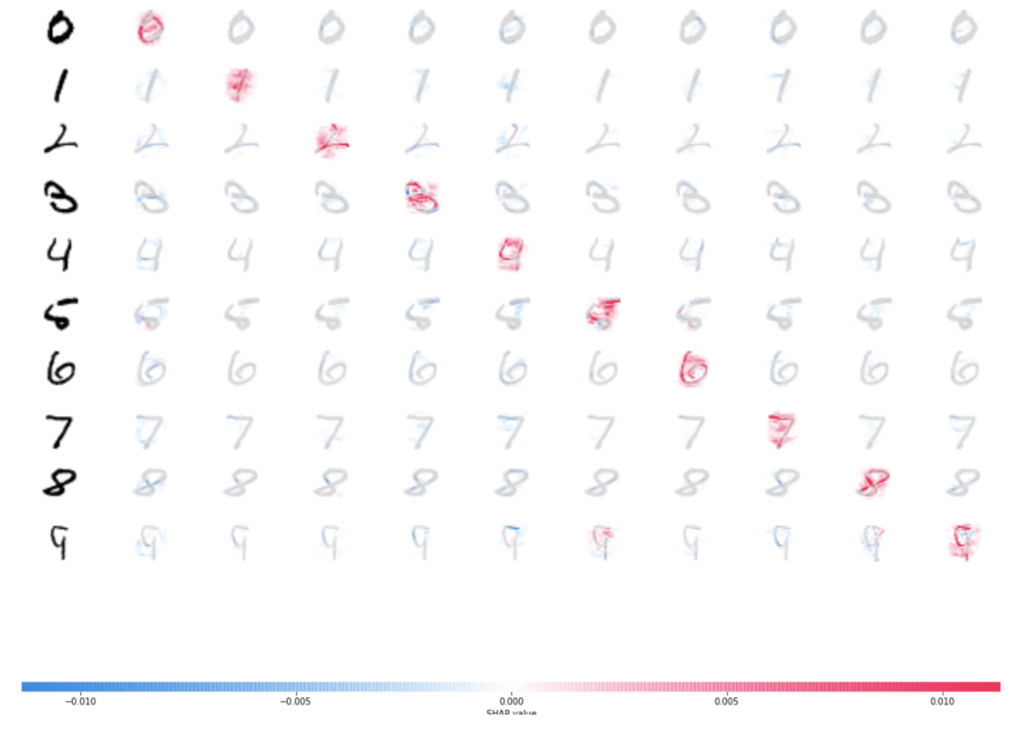
DeepExplainer explains handwritten digits
Red areas increase the probability of that class, and blue areas decrease the probability

Slide 17
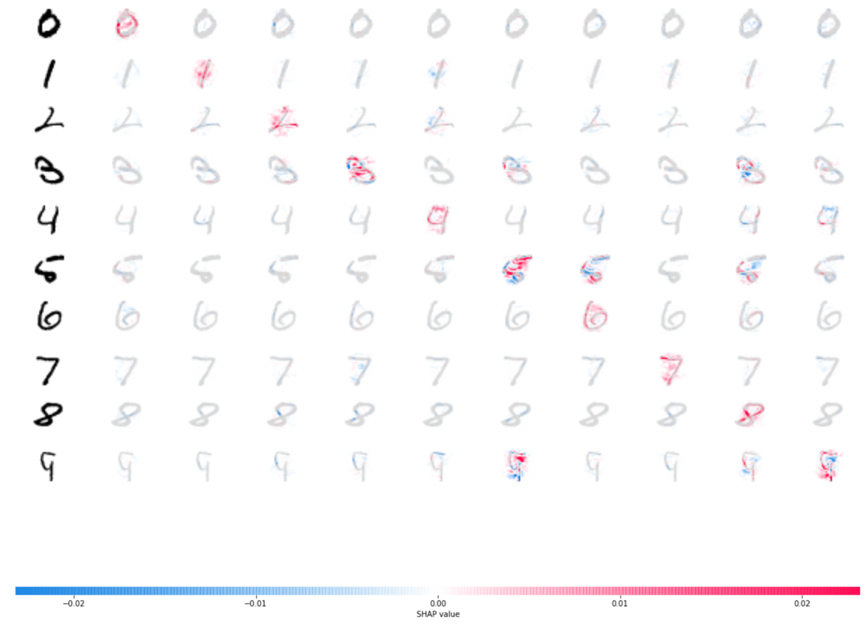
GradientExplainer explains handwritten digits
Similar to DeepExplainer

Slide 18
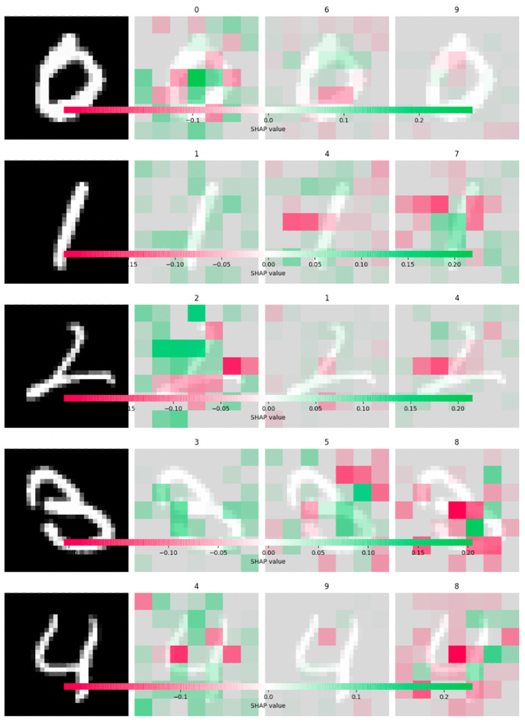
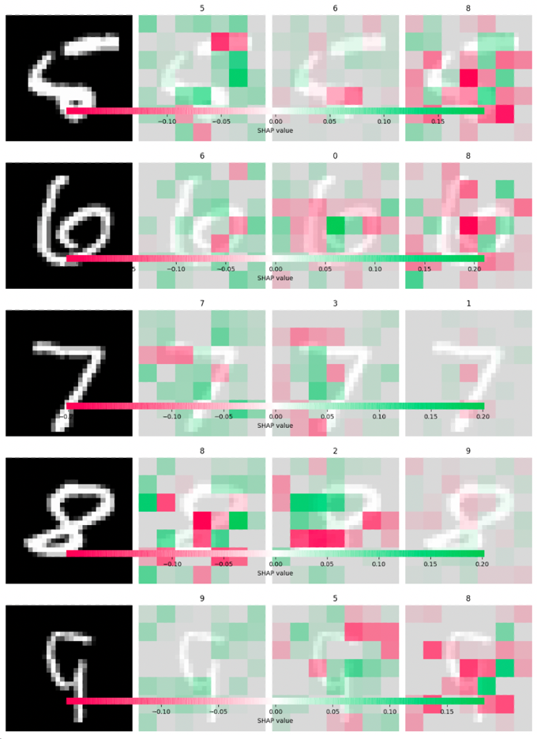
KernelExplainer explains handwritten digits
Hard to understand.

Slide 19
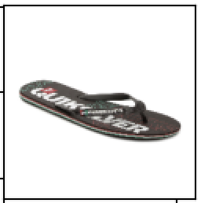
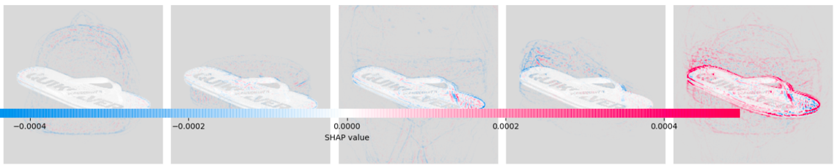
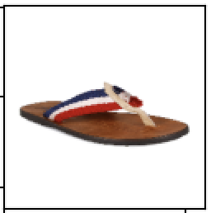

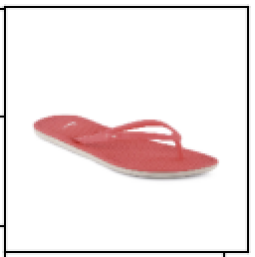
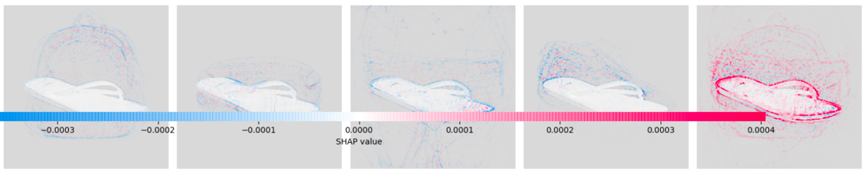
DeepExplainer explains flip flops
Backpacks Belts Briefs Casual Shoes Flip Flops

Slide 20
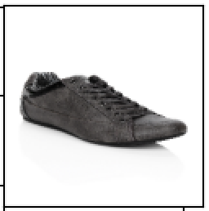
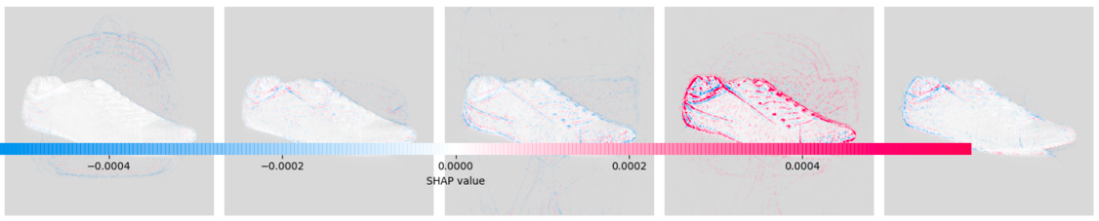
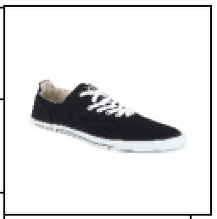
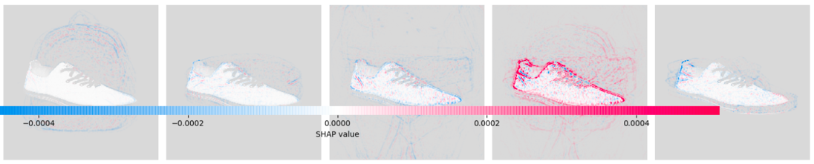
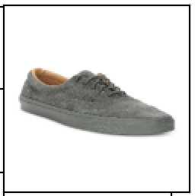
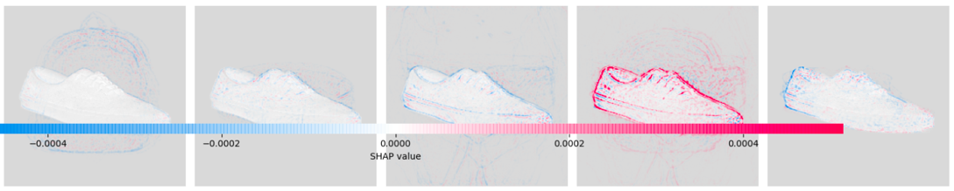
DeepExplainer explains casual shoes
Backpacks Belts Briefs Casual Shoes Flip Flops

Slide 21
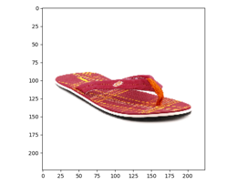
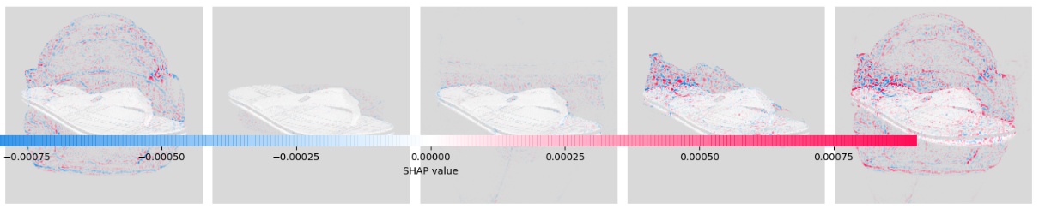
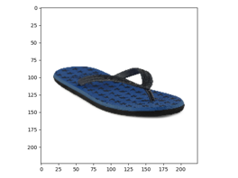
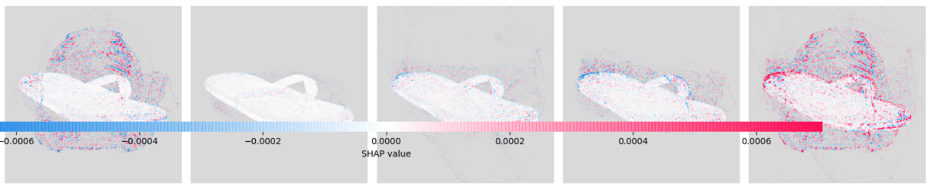
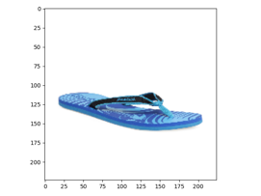
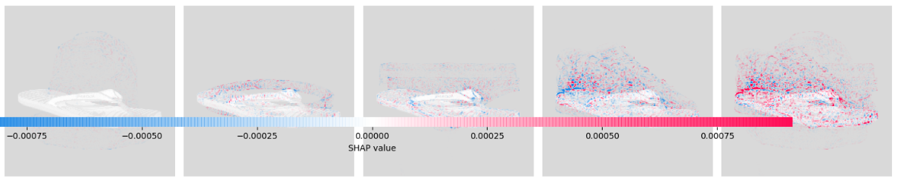
GradientExplainer explains flip flops
Backpacks Belts Briefs Casual Shoes Flip Flops
sparse

Slide 22
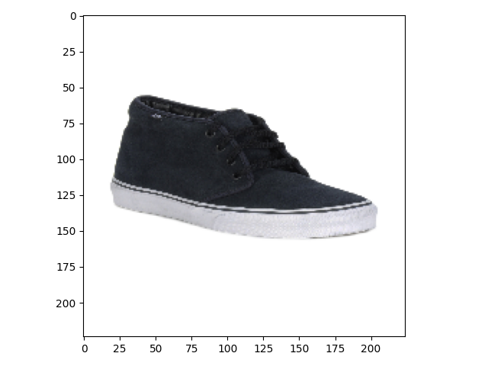
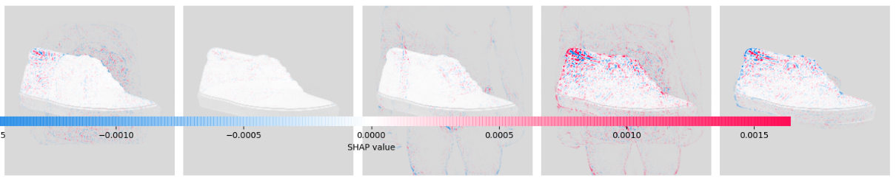
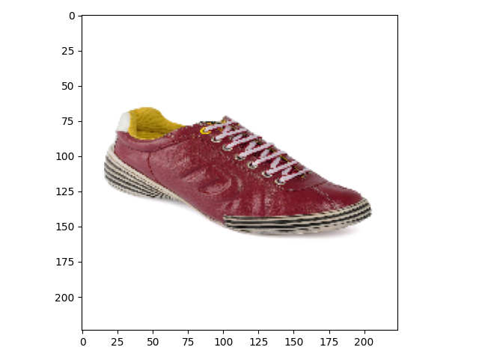
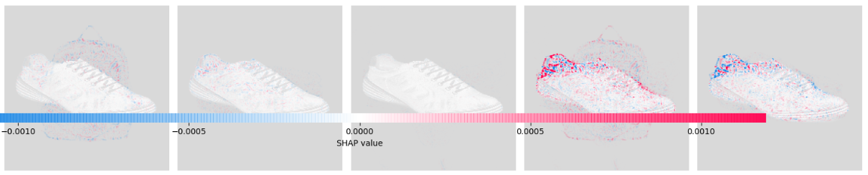
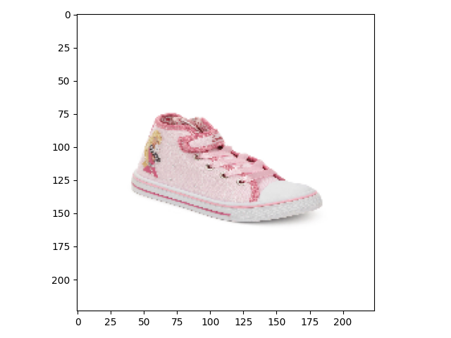

GradientExplainer explains casual shoes
Backpacks Belts Briefs Casual Shoes Flip Flops

Slide 23




KernelExplainer explains casual shoes & flip flops

Slide 24

LIME
LIME (Local Interpretable Model-Agnostic Explanations)
a technique to explain the predictions of any machine learning classifier
approximating the underlying model by an interpretable one (linear model), learned on perturbations of the original instance (hiding parts of the image).
Implementation:
pip3 install lime
keras: 2.4.3

Slide 25


LIME
We take the image on the left and divide it into interpretable components (contiguous superpixels).
we then generate a data set of perturbed instances by turning some of the interpretable components “off”
For each perturbed instance, we get the probability that a tree frog is in the image according to the model.
We then learn a simple (linear) model on this data set, which is locally weighted.
we present the superpixels with highest positive weights as an explanation, graying out everything else.

Slide 26










LIME explains handwritten digits

Slide 27












LIME explains casual shoes & flip flops
unstable

Slide 28
Comparison
04

Slide 29










Handwritten Digits
DeepLIFT
DeepExplainer
KernelExplanier
GradientExplainer
LIME

Slide 30
























Flip Flops
DeepExplainer
GradientExplainer
KernelExplanier
LIME
DeepLIFT
Time
236.47
385.6
142.02
144.1
11.39

Slide 31
























Casual Shoes
DeepExplainer
GradientExplainer
KernelExplanier
LIME
DeepLIFT
Time
224.87
382.16
139.91
144.51
11.39

Slide 32
Reference
Learning Important Features Through Propagating Activation Differences, Avanti Shrikumar, Peyton Greenside, Anshul Kundaje. https://github.com/kundajelab/deeplift
A Unified Approach to Interpreting Model Predictions, Scott M. Lundberg, Su-In Lee. https://github.com/slundberg/shap
“Why Should I Trust You?” Explaining the Predictions of Any Classifier, Marco Tulio Ribeiro, Sameer Singh, Carlos Guestrin. https://github.com/marcotcr/lime
Local Interpretable Model-Agnostic Explanations (LIME): An Introduction URL https://www.oreilly.com/content/introduction-to-local-interpretable-model-agnostic-explanations-lime/
Guide to Interpretable Machine Learning URL https://towardsdatascience.com/guide-to-interpretable-machine-learning-d40e8a64b6cf
Fashion Product Dataset URL https://www.kaggle.com/paramaggarwal/fashion-product-images-dataset

Slide 33
Thanks for your listening

